Slide 1

Odessa College: Evaluation of Student Learning
Academic Year 2024-2025

Slide 2
“Assessment is the process of evaluating student learning by measuring how well students have achieved the intended learning outcomes.”

Slide 3
In what ways can we refine our assessment methods to ensure that they not only measure student achievements of learning outcomes, but also provide actionable insights that can enhance both teaching practices and student success?

Slide 4
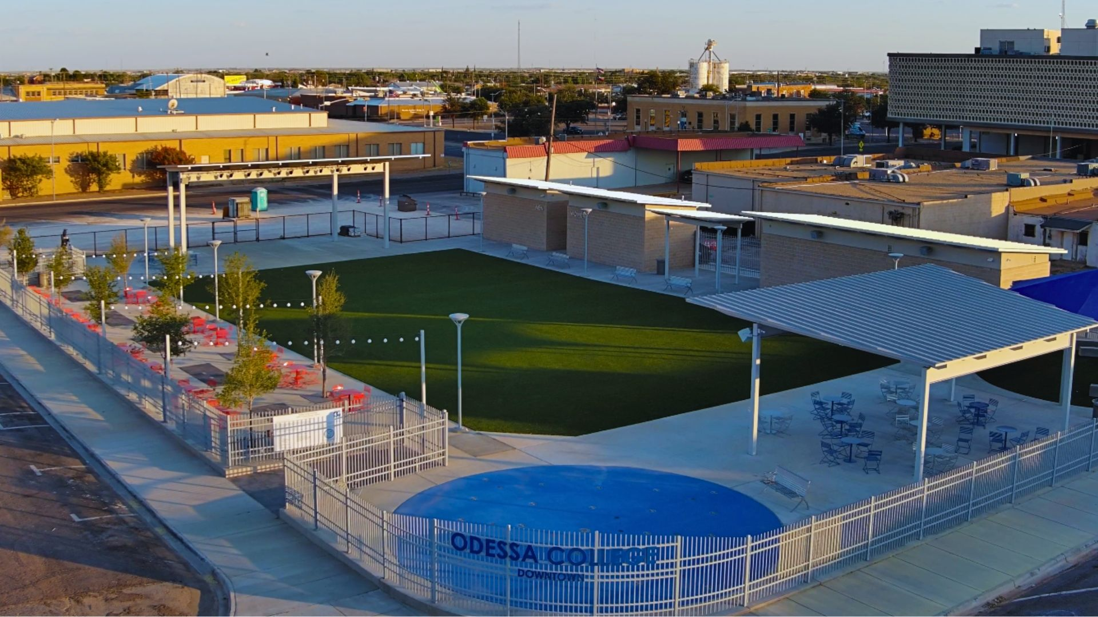
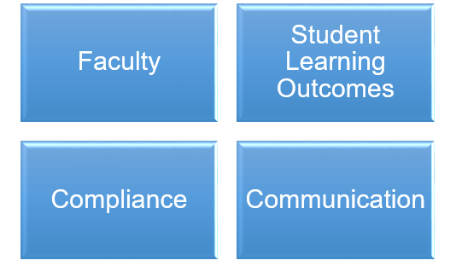
Four Pillars of Assessment
Faculty— Both full-time and part-time are engaged in the assessment process.
Student Learning Outcomes— reflect OC’s student learning experiences in their courses, programs, and at the college.
Compliance—We measure where learning is demonstrated, and provide qualitative and quantitative data as it pertains to student learning across OC.
Communication—The evaluation of student learning across the college is done in collaboration with other departments, and we will communicate our assessment data to our stakeholders at OC, the state of Texas (THECB) and our regional accreditation body (SACSCOC).

Slide 5
Odessa College Assessment Framework

Slide 6
Odessa College-Evaluation of Student Learning through Assessment
Odessa College’s commitment to student success is founded on an integrated approach to learning. We believe learning is multi-faceted, and the evaluation methods included in our student learning framework are designed as a snapshot for the journey of student learning at Odessa College.
The framework includes an evaluation of student learning via Odessa College Course Mastery Assessment, Core/General Education student learning outcomes, and program student learning outcomes.
This approach directly influences various facets of our curriculum. Through a blend of assessments of student learning, reflections on learning, and continuous improvements on pedagogical strategies, we strive to ensure that every student not only reaches, but surpasses their academic and personal potential.

Slide 7
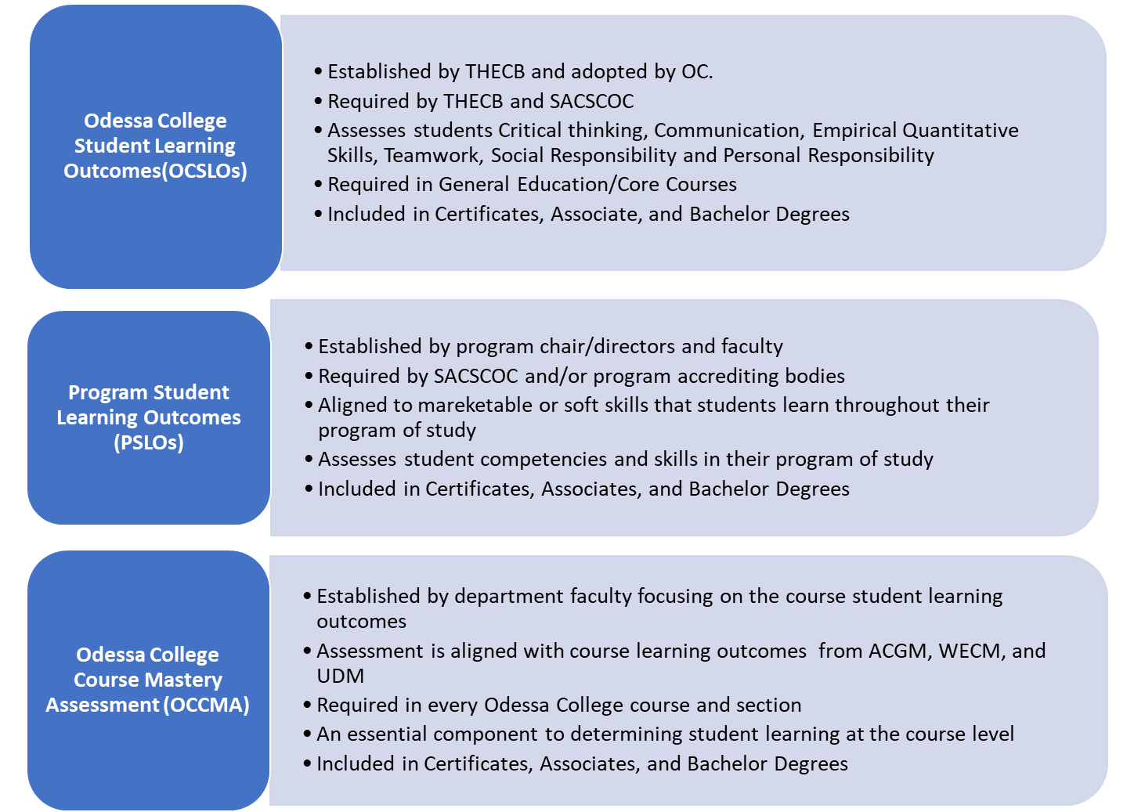

Slide 8
Odessa College Course Mastery Assessment-OCCMA
The OCCMA provides evidence that students are achieving the intended course outcomes.
It reflect our college’s dedication to verifying students not only acquire knowledge but can also meaningfully apply and communicate their acquired knowledge in each course, regardless of modality, faculty status (I.e., full/part time), or other varying factors.

Slide 9
Odessa College Course Mastery Assessment-Examples
Capstone Project—allows students to demonstrate their mastery of course content and learning outcomes. * Solve a real-world problem or complete significant task relevant to the course or field of study.
Portfolio-provide a way for students to showcase their progress over time, highlighting their best work and reflecting on their learning journey.

Slide 10
Odessa College Course Mastery Assessment-Examples
Performance Based/Case Studies & Simulations—measures students’ ability to apply knowledge and skill in a practical context. Ask student to perform tasks or complete activities that mirror real-world application of their course material.
Comprehensive Exam w/ application-based questions-focuses on students ability to apply knowledge in new situations, and also ensures students have retained key information from the course.

Slide 11
Odessa College Course Mastery Assessment-OCCMA
Starts Fall 2024/previously called End of Course Assessment.
Each department must create a uniform assessment for each course that is taught in their respective pathway.
Every instructor must implement the OCCMA in their course, and make it part of their grading schema.
Occurrence: Every term and it must be titled OCCMA in Bb.
Report is shared on student success data on OCCMAs

Slide 12
Core/General Education-Odessa College Student Learning Outcomes (OCSLOs)
The OCSLOs are the fundamental competencies and knowledge that all students, regardless of their program of study, are expected to acquire through the institution’s core curriculum. These outcomes encompass critical thinking, communication, empirical and quantitative skills, teamwork, social responsibility, and personal responsibility.
They are designed to ensure that graduates possess a well-rounded educational foundation, preparing them for both professional success and informed and engaged citizenship.

Slide 13
Core Component Areas | Odessa College Student Learning Objectives (OCSLOs) and Institutional Core Objectives (ICOs)
Critical Thinking | Odessa College students will demonstrate the ability to analyze and interpret information to form opinions and make decisions. This involves being able to evaluate the strengths and weaknesses of an argument, identify underlying assumptions, and make reasoned judgments.
Communication | Odessa College students will demonstrate the ability to effectively express and exchange information and ideas with others. It involves being able to articulate thoughts and opinions clearly and concisely, and to listen actively and respond in an appropriate manner.
Empirical Quantitative Skills | Odessa College students will demonstrate the ability to collect, analyze, and interpret data using quantitative methods. It involves being able to understand mathematical concepts and formulas and to use them to make observations and draw conclusions based on evidence.
Teamwork | Odessa College students will demonstrate the ability to work effectively with others to achieve a common goal. It involves being able to communicate and collaborate with team members, contribute to a positive team environment, and recognize and value the strengths and perspectives of others.
Social Responsibility | Odessa College students will demonstrate the ability to commit to acting ethically and making positive contributions to the community and broader society. It involves being aware of and responsive to social issues, and knowing how to take action that promotes the well-being of others.
Personal Responsibility | Odessa College students will demonstrate the ability to take ownership of one’s actions and decisions, and to be accountable for consequences. It involves being able to set goals, manage time effectively, and make responsible choices that contribute to personal growth and development.

Slide 14
Core/General Education-Odessa College Student Learning Outcomes (OCSLOs) Examples
Critical Thinking Assessment: Case Study Analysis
Communication: Formal Presentation
Empirical & Quantitative Skills: Data Analysis Project
Teamwork: Collaborative Project with identified roles for each member and reflection
Social Responsibility: Community Engagement or Service Learning Project
Personal Responsibility: Personal Development Plan

Slide 15
Core/General Education-Odessa College Student Learning Outcomes (OCSLOs)
Started Spring 2024
Each core curriculum course has specific OCSLOs they must assess. (see chart)
The OCSLO assessment must be aligned to its specific assessment goal in Bb
Occurrence: Every term the course is taught.
Bb outcomes assessment pulls artifacts & volunteer faculty score OCSLOs using standard college rubric. (Jan./Feb. sessions)
Report is shared on student success data on OCSLOs

Slide 16
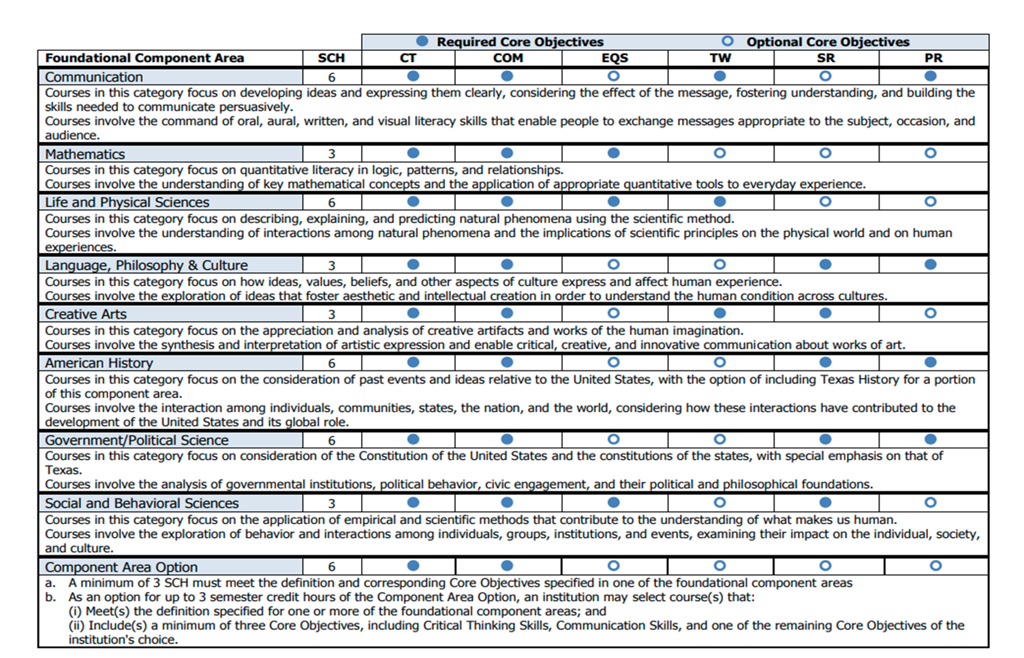

Slide 17
Program Student Learning Outcomes (PSLOs)
PSLOs are defined as the specific knowledge, skills, and abilities students are expected to demonstrate upon successful completion of a program.
These outcomes are carefully designed to align with industry standards and academic expectations, ensuring that graduates are well-prepared to excel in their chosen careers or further educational pursuits.

Slide 18
Program Student Learning Outcomes (PSLOs)
Start Fall 2024
There are specific courses within a program pathway that have been chosen to asses a PSLO.
The PSLO assessment must be aligned to its specific assessment goal in Bb.
Occurrence: Every term the specific course is taught.
Bb outcomes assessment pulls artifacts & program faculty score PSLOs assessment
Report is shared on student success data on PSLOs

Slide 19
Odessa College Assessment Bb Alignment

